Slide 1
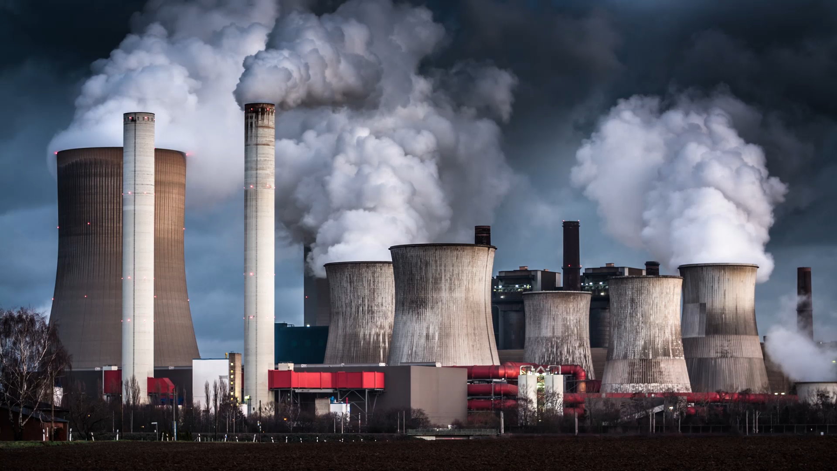
Environmental Protection, Occupational Health and Safety 12
Assoc. Prof. Dr. Fatma Tuğçe ŞENBERBER DUMANLI
fatma.senberber@nisantasi.edu.tr

Slide 2
Hazard Prevention and Control
PROTECTION
These are the studies carried out to prevent the employees from being adversely affected if health and safety risks are not prevented.
PREVENTION
It is defined as all the measures planned and taken to eliminate or reduce the risks related to occupational health and safety at all stages of the work carried out in the workplace.
(OHS Law of Turkey)

Slide 3

GENERAL OBLIGATIONS IN PREVENTION POLICIES
Taking precautions
To inform the employees
Collaborating with employees
Making the necessary controls
Registration - notification requirement

Slide 4

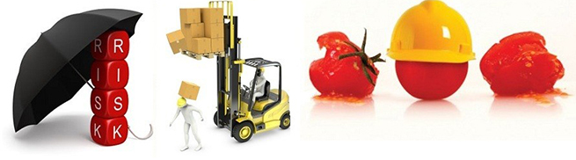
OHS have two main objectives.
Improving health conditions
Improving security conditions

Slide 5

The things to be taken into consideration in the Prevention Policies are listed below:
Developing a general prevention policy in workplaces
Continuous improvement of the situation regarding occupational health and safety
Prevention of risks
Analysis and evaluation of risks that cannot be prevented
Struggle with risks at source
Informing the employees about the risks that may be encountered in the workplace
Ensuring the participation of employees in OHS related activities
Assignment of employee representative and support staff in the workplace
Receiving employees' opinions on OHS

Slide 6

Employer's obligations
Prioritizing collective protection measures and personal protection measures
Giving appropriate instructions to workers
The organization of the workplace
To evaluate all risks in terms of workers' health and safety
Work planning should be made according
to the worker, not the business.

Slide 7
Hierarcy of controls
If the danger cannot be prevented, the risk is revealed and then the fight against the risk begins. The order of measures to deal with the risk;
Source protection measures,
Protection measures according to the environment,
Personal protection measures (PPE)
PREVENT AND PROTECT IS EASIER, CHEAPER AND HUMANITARIAN THAN ALWAYS TO PAY.

Slide 8
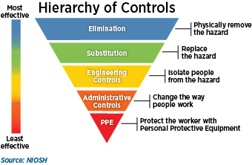

Slide 9

Example
In a workplace with noisy machinery, list the protection measures given below in order of priority.
Training employees on noise protection measures
Replacement of 95 dB machines with 85 dB machines
Distributing headphones to employees
Putting noisy machines indoors
Notes:
CEVAP: II, IV,I,III

Slide 10
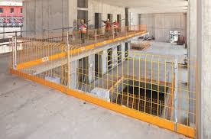
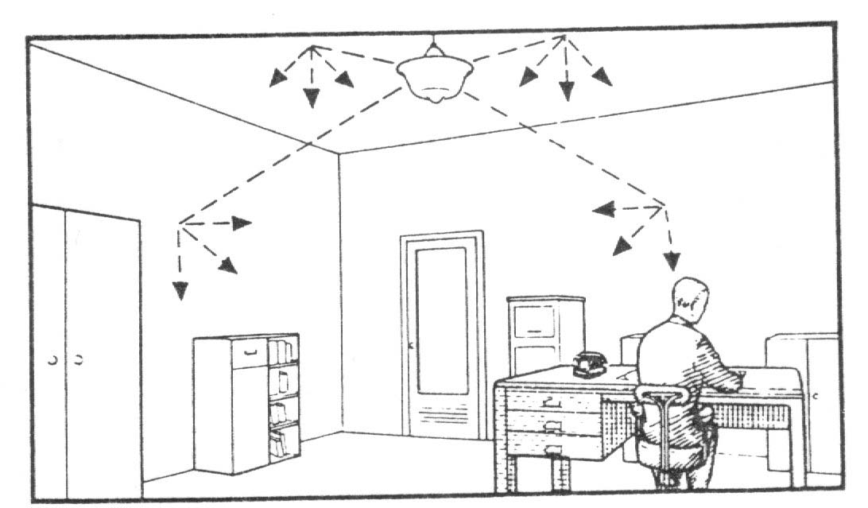
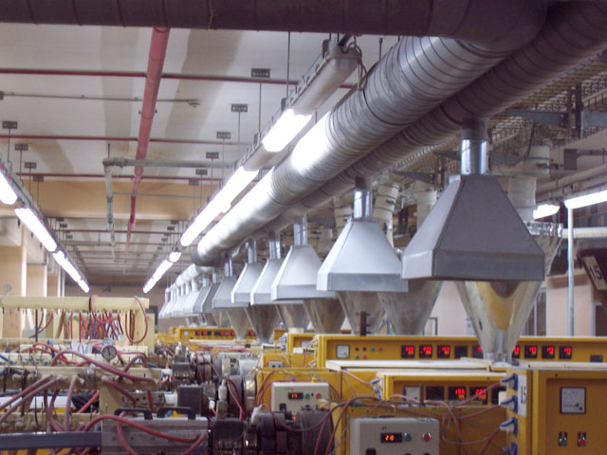
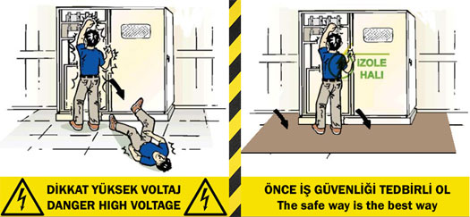
Collective Protection (Engineering) Measures
Insulation
Machine protectors
Ventilation
Lighting
Air conditioning
Warning signs and marking

Slide 11

Collective Protection (Administrative) Measures
Personnel selection, training and supervision suitable for the job,
Rotation
Recruitment health examination,
Periodic health examinations,
Return medical examinations,
Providing rehabilitation services
Ensuring adequate and balanced nutrition
Organization of first aid and rescue work
Ensuring general hygiene conditions

Slide 12
Personal protective equipment (PPE)
Personal protective equipment is protective clothing, helmets, goggles, or other garments or equipment designed to protect the wearer's body from injury or infection.
The hazards addressed by protective equipment include physical, electrical, heat, chemicals, biohazards, and airborne particulate matter.

Slide 13
Personal protective equipment (PPE)
In the risk assessment hierarchy, it should be the last protection measure that comes to mind.
PPE is the property of the employer. It is given to the employee free of charge.
An employee who does not use PPE and continues not to use it despite being warned may be dismissed without compensation.
It cannot be taken out of the workplace without permission.

Slide 14
WHAT HAZARDS SHOULD WE PROTECT THE EMPLOYEE?
CHEMICAL SPILL, SPRAY AND ENVIRONMENTS
HOT ENVIRONMENTS AND SURFACES
COLD ENVIRONMENTS AND SURFACES
HAZARDOUS DUSTS, FOGS, FUMES
LIGHT AND RADIATION
SHARP POINTED OBJECTS
COMPACTIONS, HITS AND FALLS

Slide 15
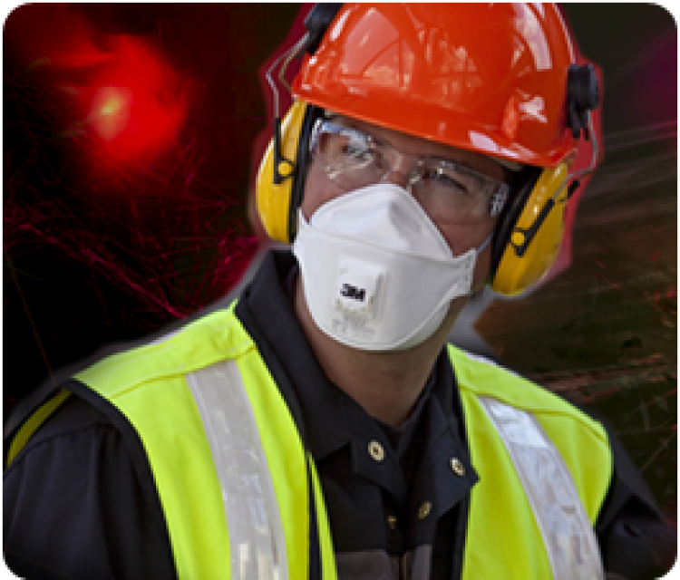
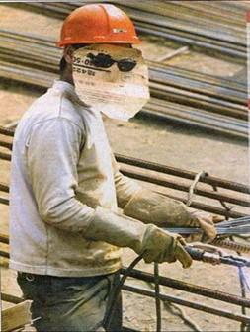
CONSIDERATIONS WHEN SELECTING PPE
PPE MUST BE SUITABLE FOR THE BUSINESS TO BE USED.
SHOULD PROVIDE SUFFICIENT PROTECTION.
THE NEEDS OF THE PERSON WHO WILL USE PPE SHOULD BE CONSIDERED.
ALSO THE PROTECTION MUST BE ERGONOMIC AND SHOULD NOT RESTRICATE MOBILITY.
PPE TO BE USED SHOULD COMPLY WITH THE REGULATIONS ON THIS SUBJECT.
ALL OF THE NEEDS ARISING IN THE WORK IN THE WORKPLACE SHOULD MEET.

Slide 16
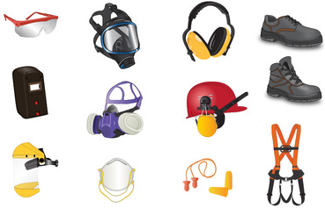
Types of PPE
Head guards
Ear guards
Eye and face protectors
Respiratory system protectors
Hand and arm protectors
Foot and leg protectors
Body, Torso and Abdominal Protectors

Slide 17
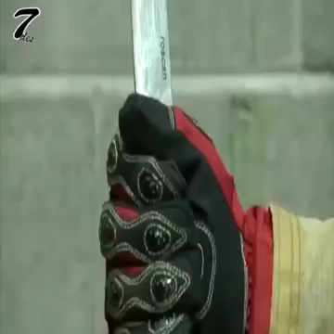
HOW MUCH CAN A GLOVE BE PROTECTIVE?

Slide 18
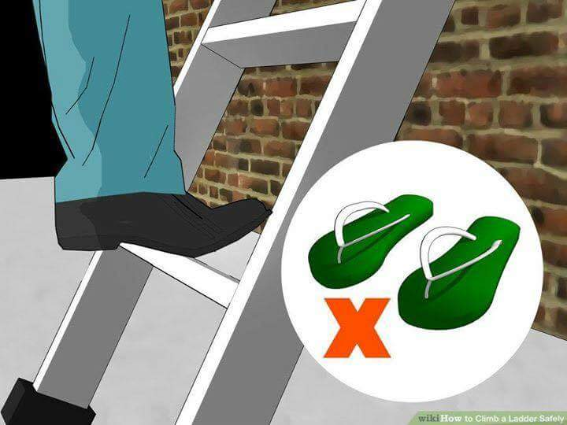
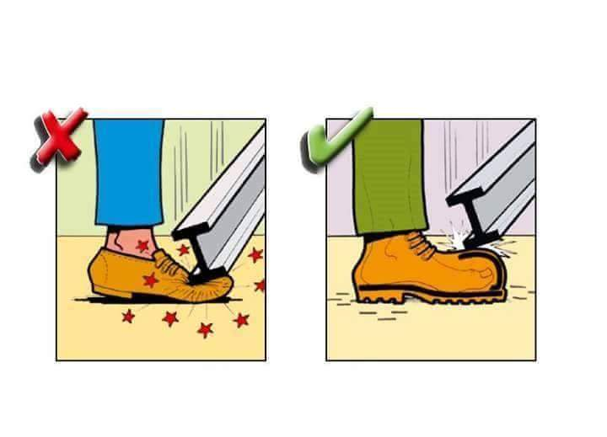
protection of feet

Slide 19
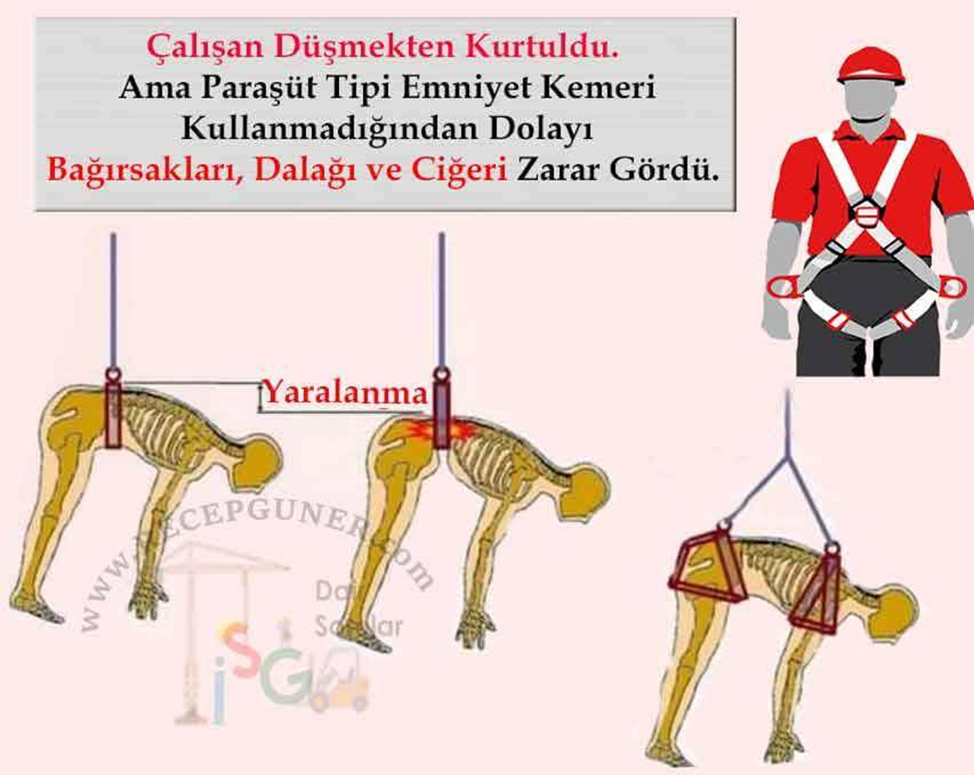
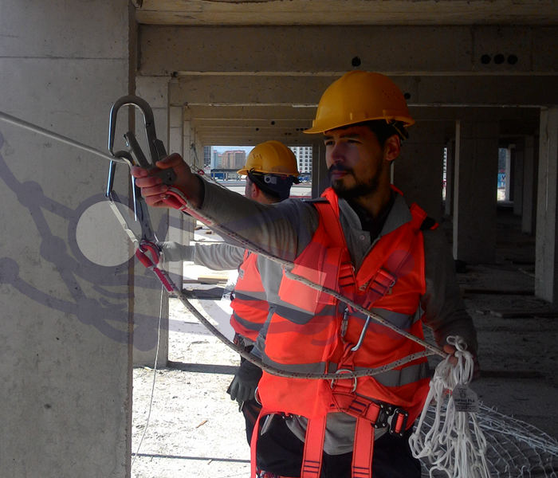
fall arrest equipment

Slide 20
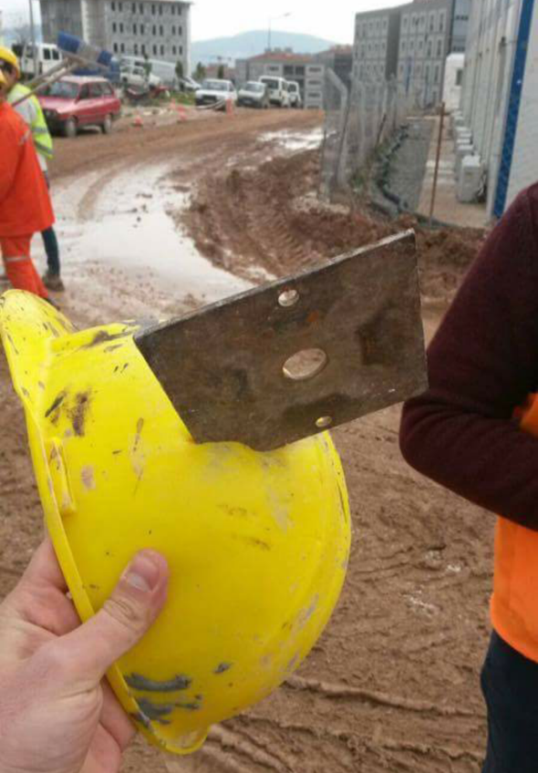
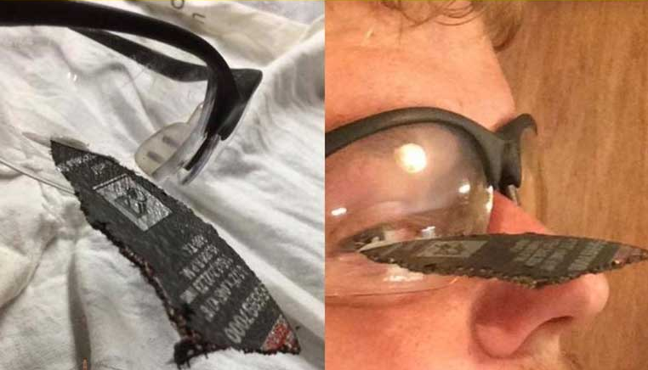
true stories ☹

Slide 21
WHAT DID YOU LEARN TODAY?
Notes:
How does job satisfaction influence an individual’s safety?

Slide 22



